Slide 1
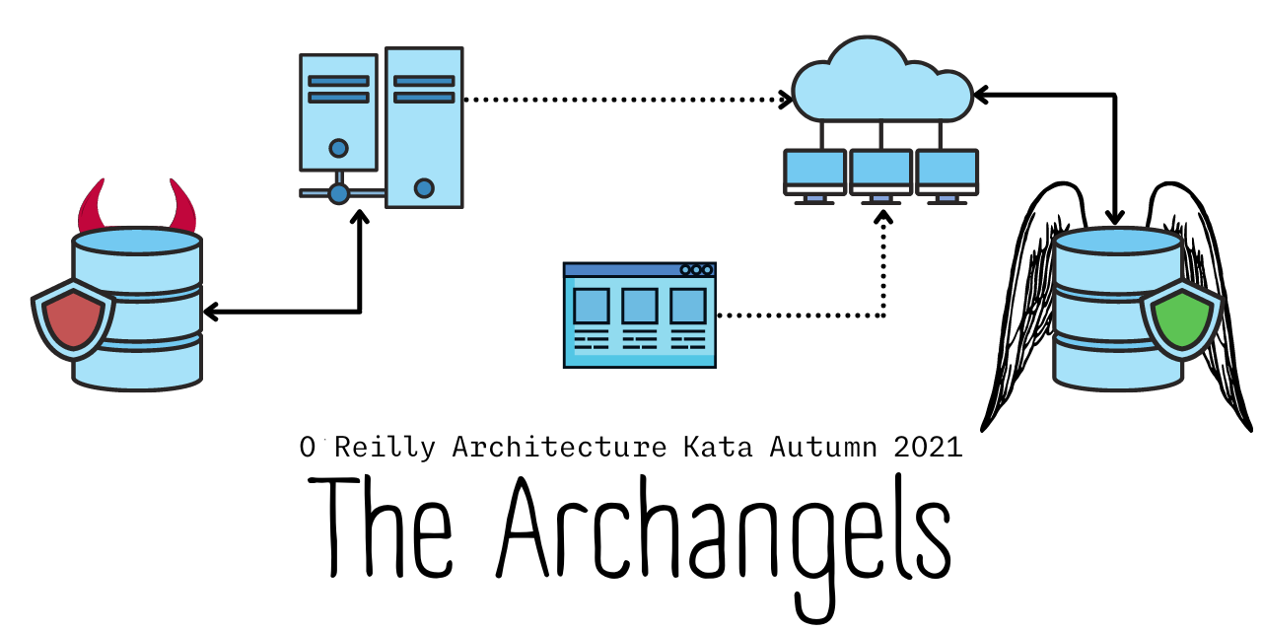

Jacqui Read | Luke Gee | Shenal Silva | Vikram Pawar
Notes:
Welcome to our entry to the O’Reilly Architectural Kata 2021.

Slide 2


Notes:
Farmacy Foods is an existing system designed by Archcolider in the previous O’Reilly Architectural Kata.

Slide 3

Notes:
Farmacy Family is an enhancement to the system to cater to the needs of customers like Miriam and Oliver.

Slide 4

Miriam
Hi, I’m Miriam. Farmacy Foods has helped me improve my diet, but I don't know where to take it from here. I wish I was able to share experiences and goals with other like minded people and get help from experts.
Notes:
Farmacy foods has helped Miriam improve her diet, but she doesn’t know where to take it from there.
She wishes to share her experiences and goals with other like-minded people and get help from experts.

Slide 5


Oliver & Lance
Hi, I’m Oliver, foster father to Lance, who has had a hard time with undiagnosed intolerances on top of that. Now I know what he needs from his diet I can make more of a difference, but the food he needs isn’t always available.
Notes:
Oliver is foster father to Lance, who has had hard time with undiagnosed food intolerances.
Oliver now knows what his son needs from his diet, but it isn't always available.

Slide 6

Architecture Analysis
Notes:
How do we satisfy these customers? We begin the architectural analysis.

Slide 7
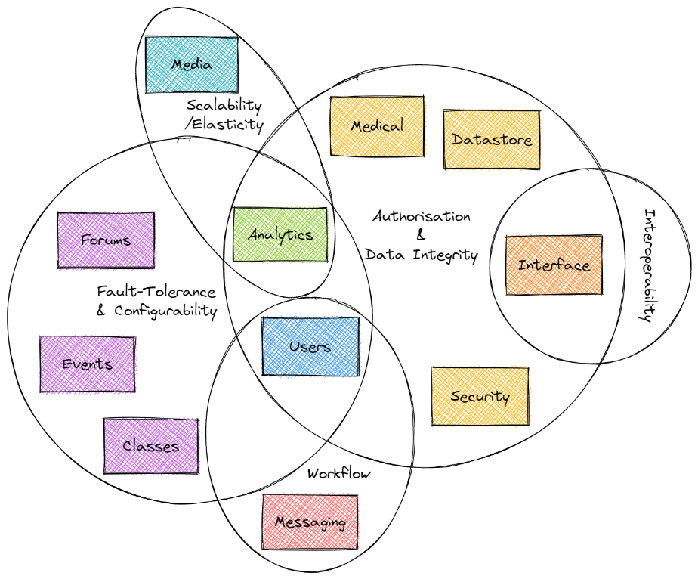
Notes:
We identified key characteristics that affect the whole system or part of it.
Architectural characteristics are shared by domains that do not overlap, so a distributed architecture is required.

Slide 8
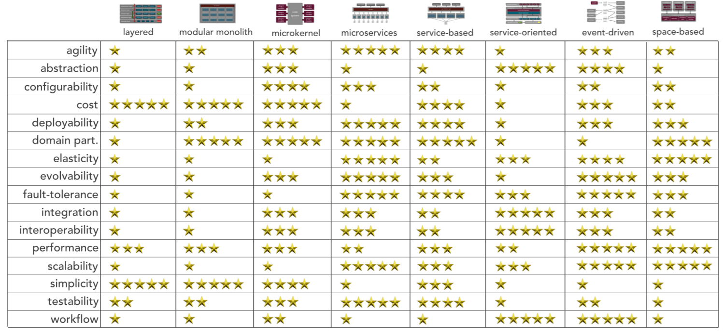
Notes:
We are looking for an architecture style with the least trade-offs

Slide 9
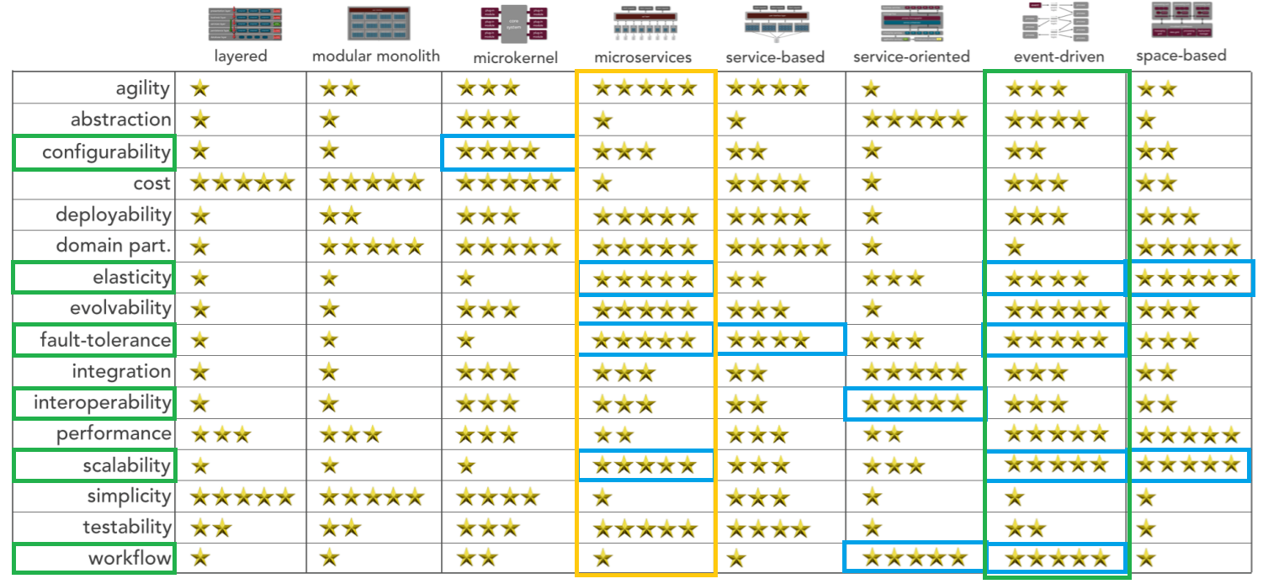
Notes:
We highlighted key architectural characteristics in green – the top three are interoperability, configurability & authorisation.
We considered microservices and event-driven architectures.
Both score high on elasticity, scalability & fault-tolerance.
Workflow is important for onboarding of customers and it scores highly in event-driven style.
The configurability is low, but configurability of the profile is the concern not that of the system.

Slide 10
Decision: We will use event-driven architecture
The trade-offs can be mitigated
Notes:
This led us to our decision to use event-driven architecture.

Slide 11

System Design
Notes:
Our architecture leads us to the following system design.

Slide 12
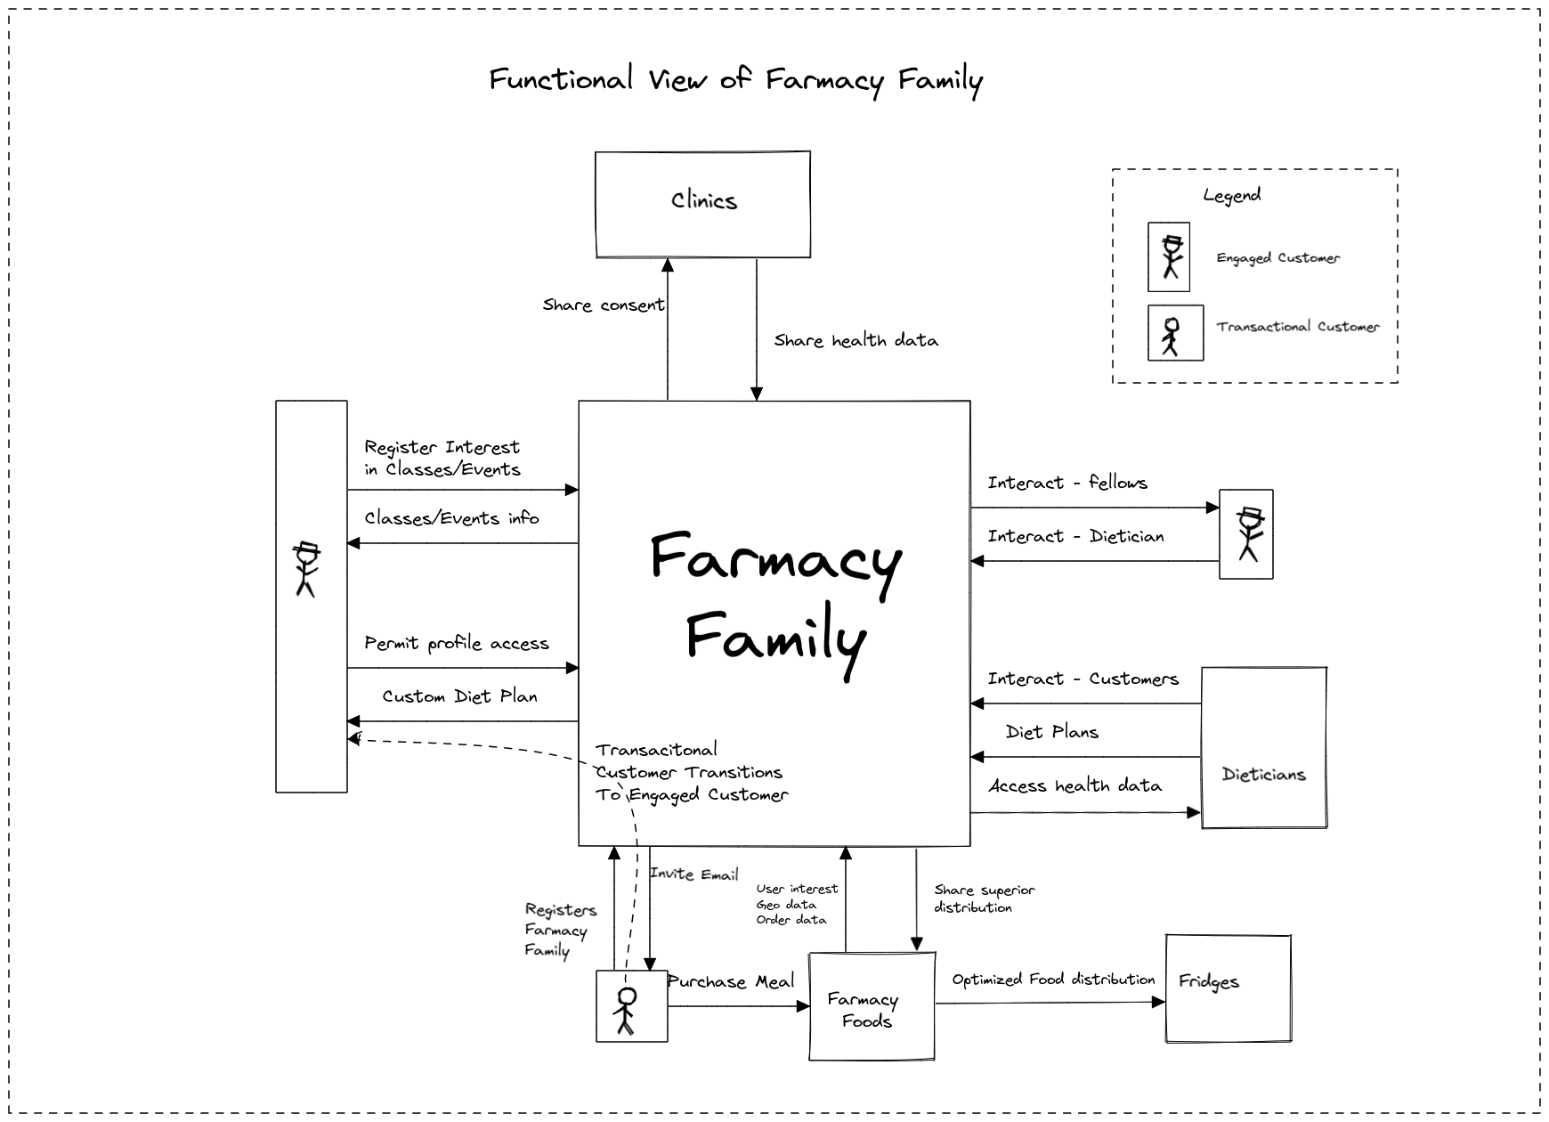
Notes:
A functional view of the requirements from Farmacy family.

Slide 13
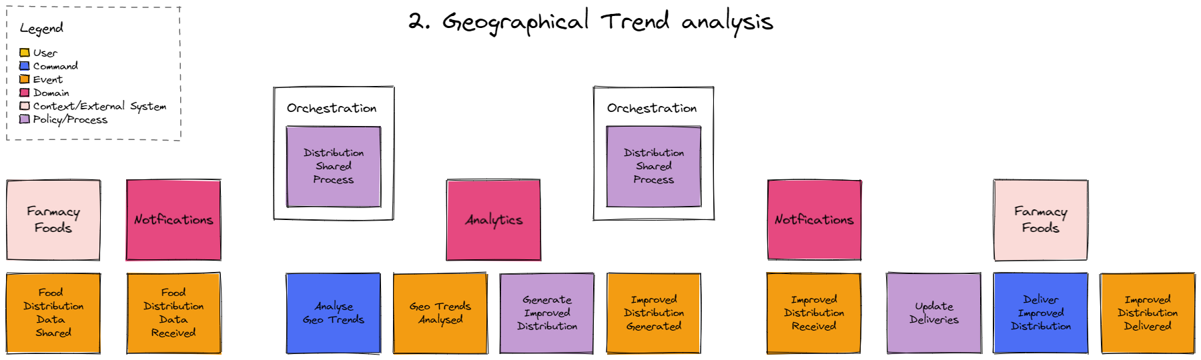
Notes:
Event-storming leads us to a better understanding of the events and their interaction.

Slide 14
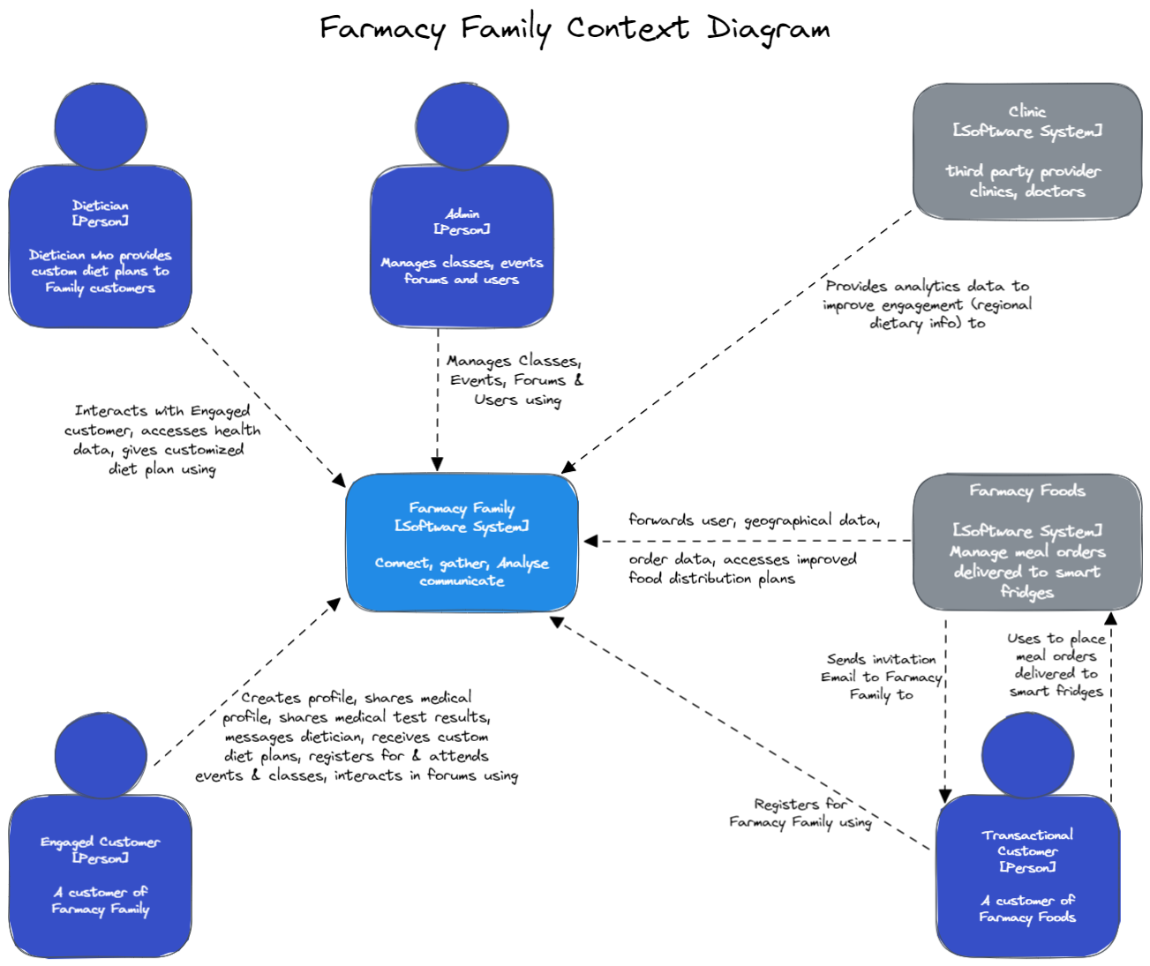
Notes:
A context diagram is the entry point. It shows how the main users of Farmacy family interact with the system.

Slide 15
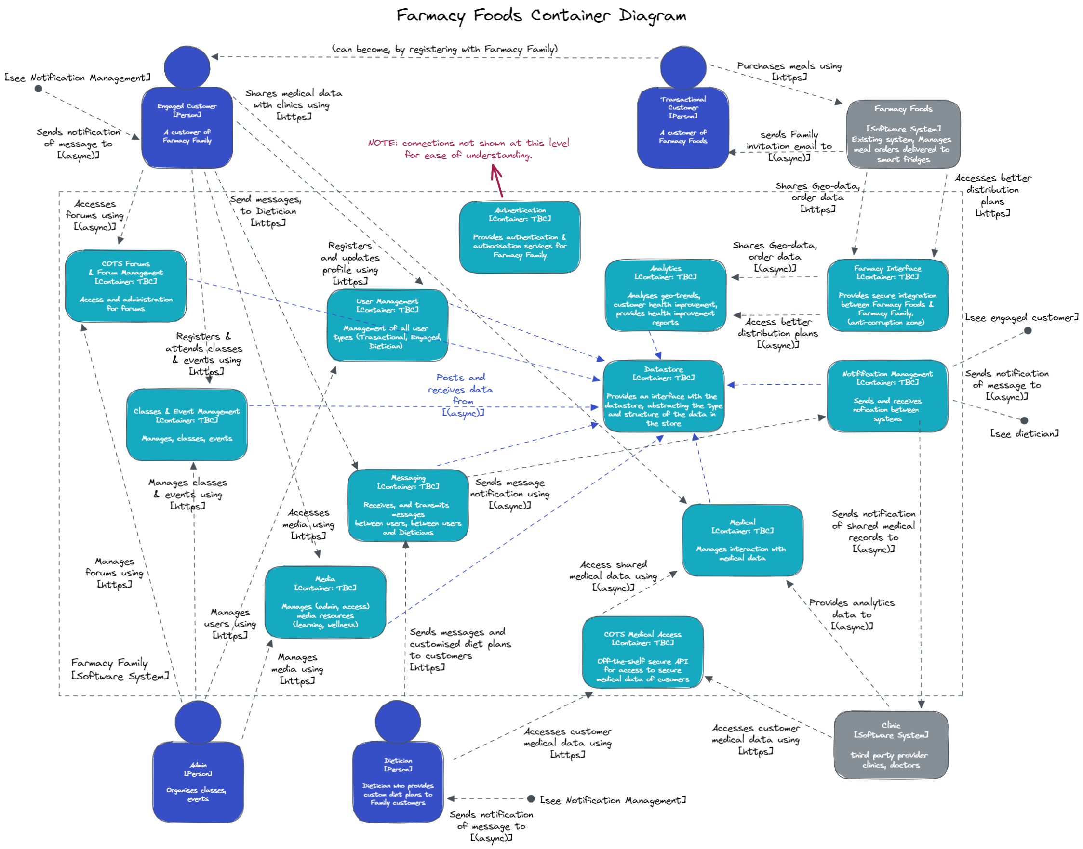
Notes:
A container diagram shows the high-level components and their interactions.

Slide 16
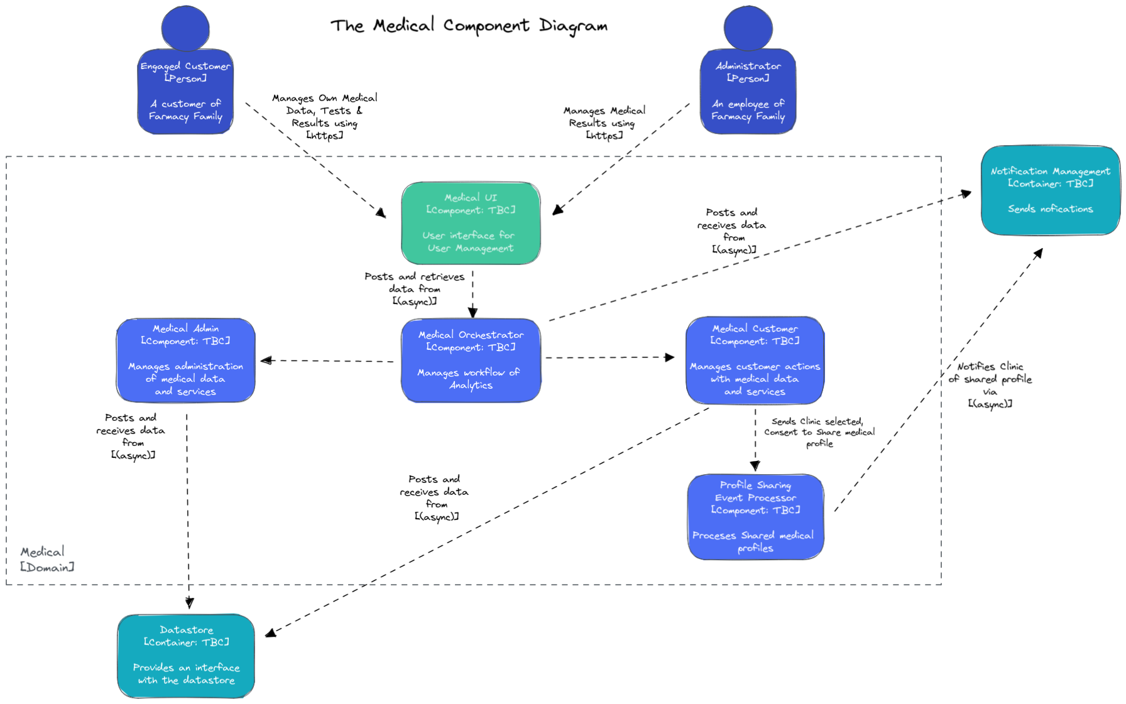
Notes:
Component diagrams for each individual component drill down further.

Slide 17
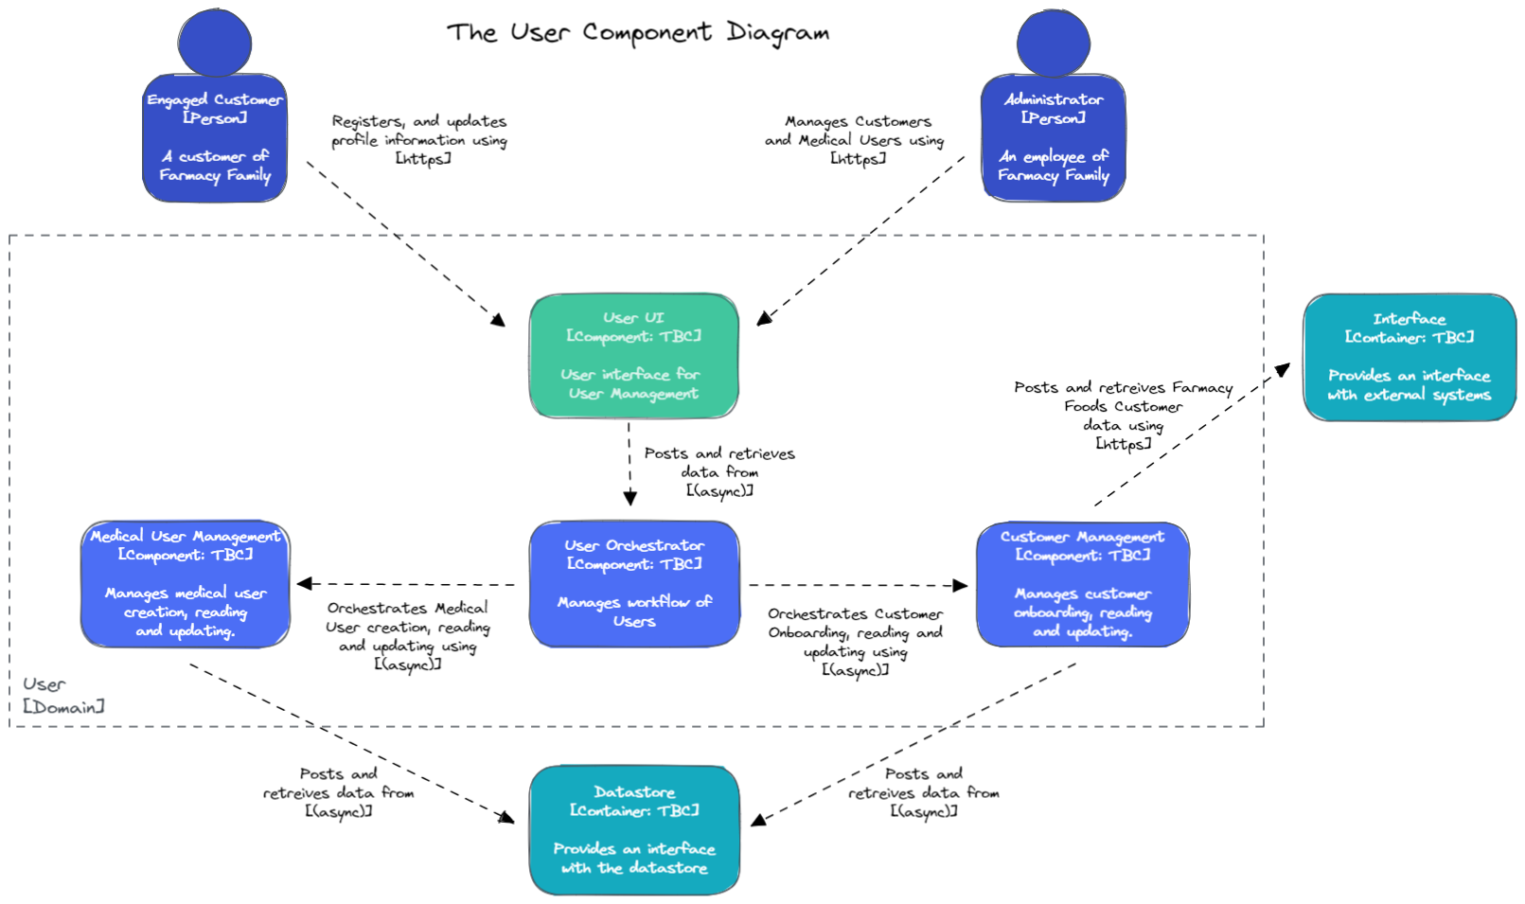

Slide 18
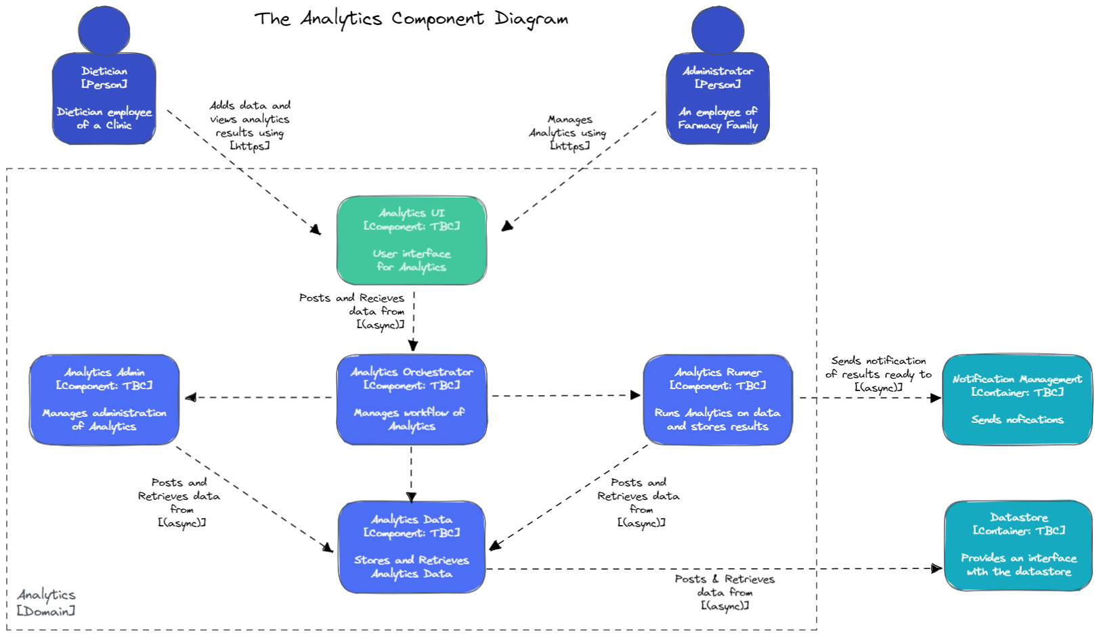

Slide 19
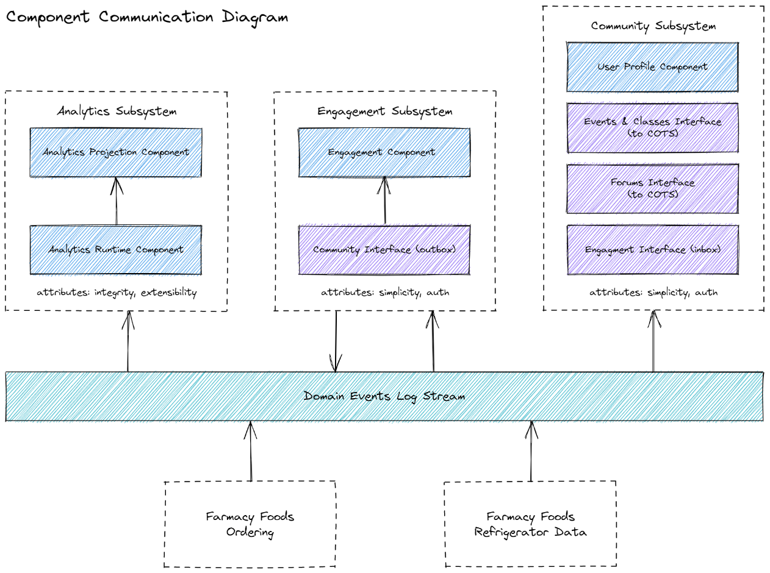
Notes:
Farmacy family will consist of 3 major components.
An analytics subsystem to analyse data from farmacy
foods to enable a more targeted approach to stocking smart fridges.
A Community subsystem to nurture relationships between groups of
customers with similar needs and provide them with a
gateway to personalised expert subject matter
And an Engagement subsystem to bring more bring more people
into the Farmacy Family
Integration between the systems enables analytics engine to feed back into Farmacy foods allowing in time restocking of fridges with what's popular and therefore less wastage. Farmacy family will consist of 3 major components.
An analytics subsystem to analyse data from farmacy
foods to enable a more targeted approach to stocking smart fridges.
A Community subsystem to nurture relationships between groups of
customers with similar needs and provide them with a
gateway to personalised expert subject matter
And an Engagement subsystem to bring more bring more people
into the Farmacy Family
Integration between the systems enables analytics engine to feed back into Farmacy foods allowing in time restocking of fridges with what's popular and therefore less wastage.

Slide 20
Notes:
Optimising food placement requires the use of real order data to understand not only what foods are being ordered, but also where the orders are being made.
The Farmacy Family system has been designed to integrate into the existing ordering log stream allowing it to pull down the data it needs as the orders are taking place
It has been designed with a dedicated analytics component that can be fed data over time allowing it to continually improve the efficiency of meal placement by using up to to date information. This means it can adapt to moving trends

Slide 21

But can I be certain Farmacy Family will keep mine and my foster son’s private information secure?
Notes:
Oliver has a genuine concern whether his son’s private information is secure.

Slide 22
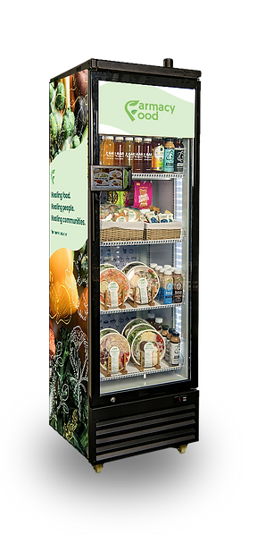
Security
Notes:
Security is one of the top architectural characteristics considered.

Slide 23
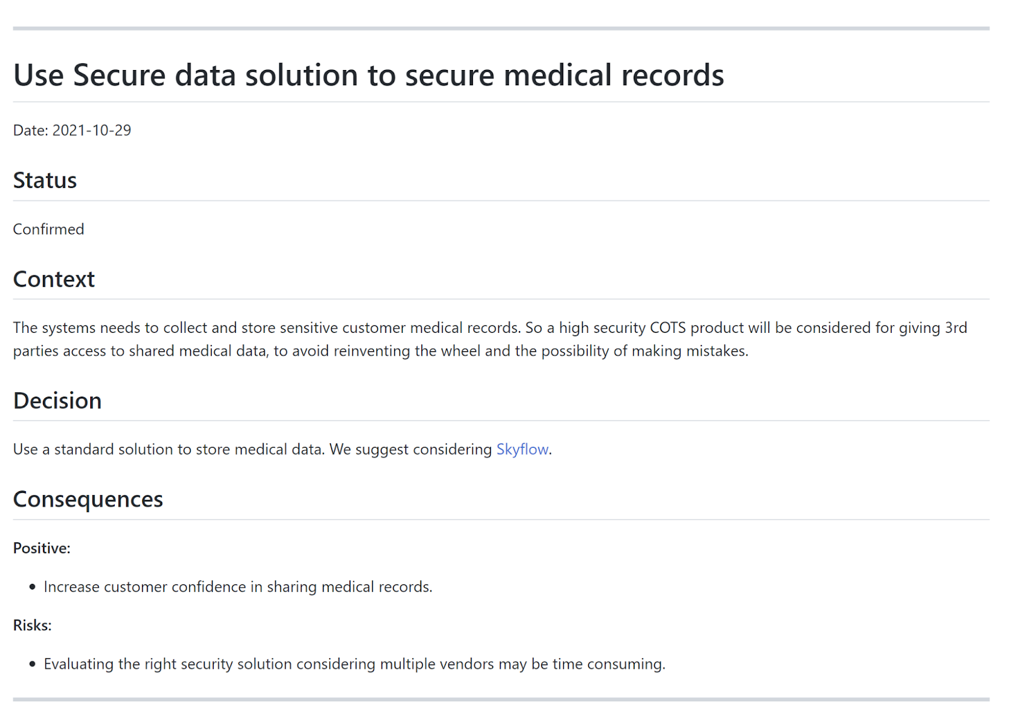
Notes:
Our ADR recommends a high security COTs solutions such as Skyflow to store medical data.

Slide 24









Identity & Access Management
GuardDuty
Firewall
Manager
Cognito
Artifact
Secrets Manager
Certificate
Manager
WAF

Slide 25
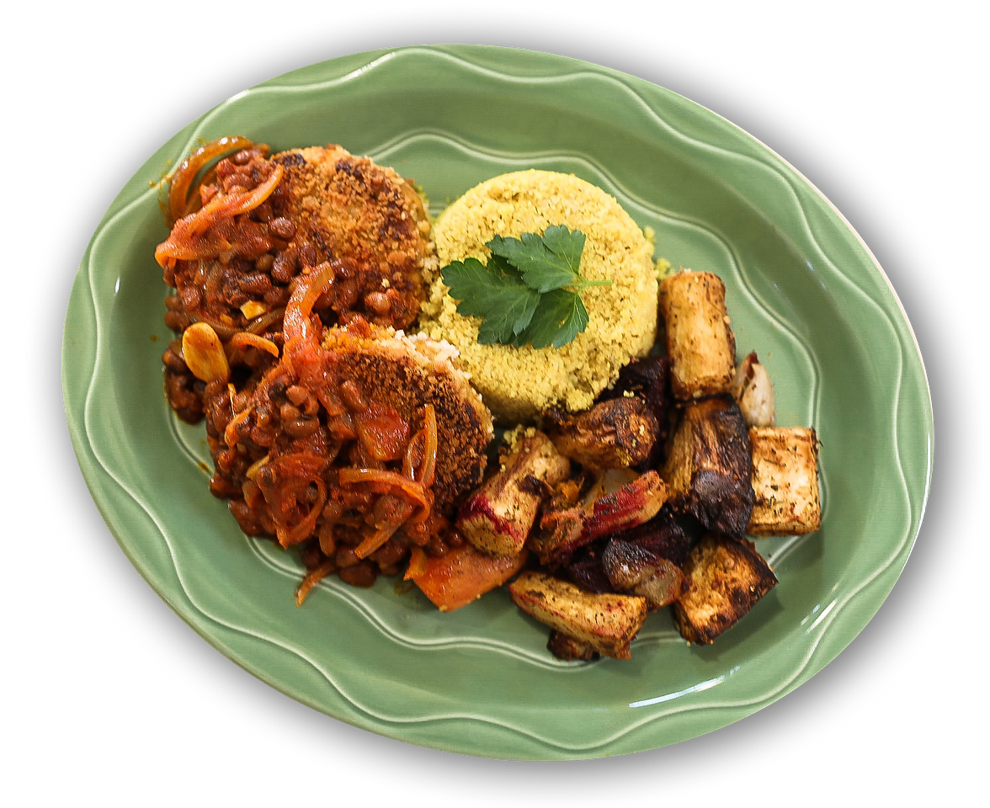
Analytics
Notes:
We come to the Analytics requirements.

Slide 26
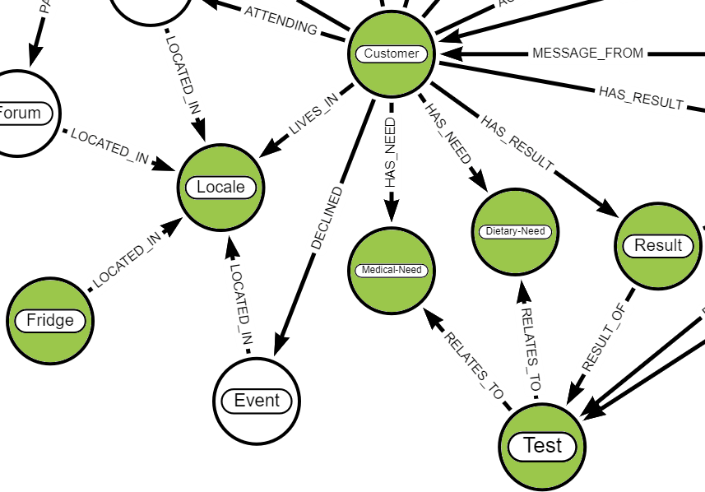
Optimising food placement requires an effective analytical capability that can use geographic trend data to ensure the right products are sent to where they are needed.
Notes:
Analytics uses data such as greographical trends, ingredients, dietrary & medical needs for analysis.
The results for a Locale drive the food distributed to the fridge in that Locale by Farmacy Foods.

Slide 27

Data Store
Notes:
We considered the different types of Data storage.

Slide 28

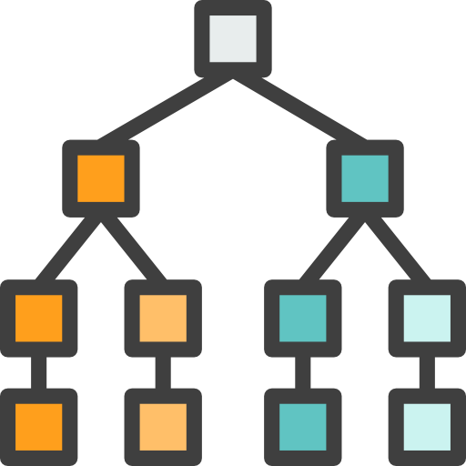


We will use blob storage for static content
We will use a graph store for analytics
[Above icons made by: relational: ultimatearm, diagram: Becris, binary-data: Juicy-Fish, nodes: Vitaly Gorbachev from www.flaticon.com]
Notes:
We evaluated the strengths and weaknesses of the storage options : graph, relational, blob and document storage, against the requirements
For highly connected data and analytics graph database would be used.
For large unstructured binary files like images, blob storage would is optimal.

Slide 29
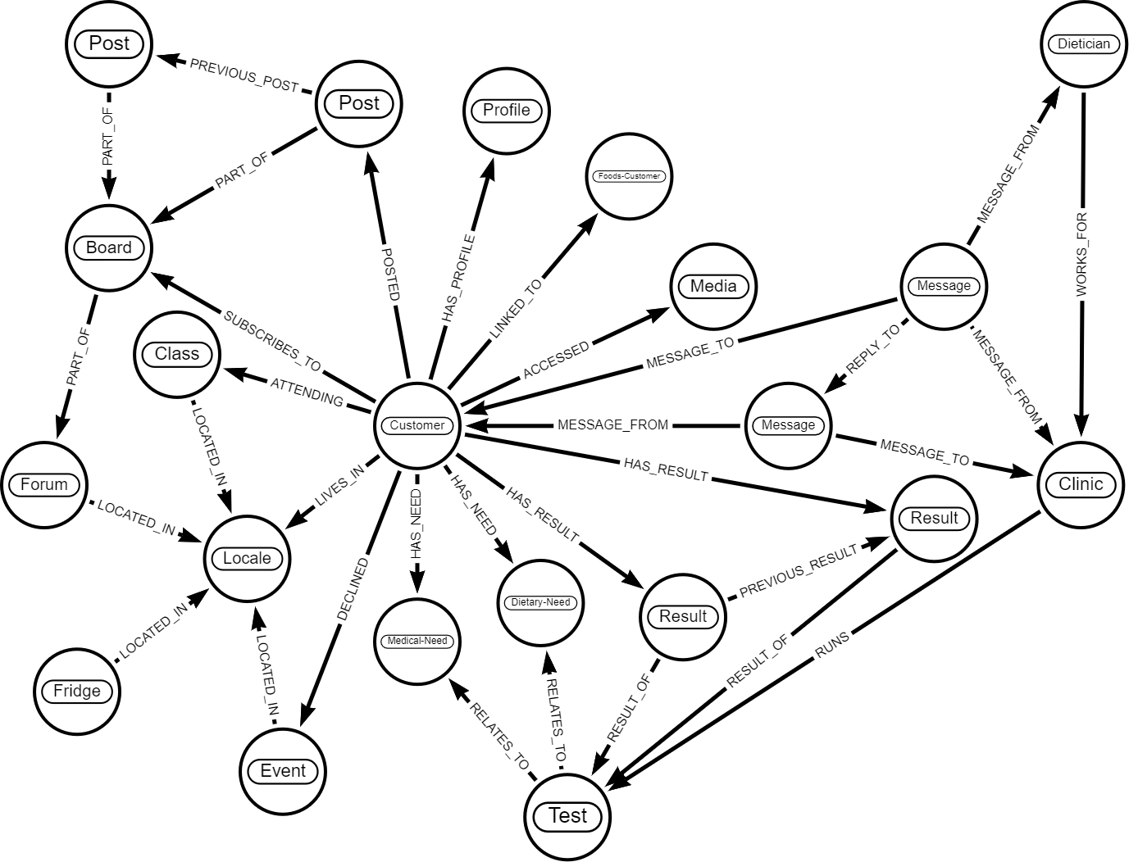
Notes:
An overview of the graph data model.
It would be divided further into more detailed models for medical, Farmacy Foods & community domains.

Slide 30
Deployment & Roadmap
Notes:
With the required architecture and system design in place, we looked at the deployment and the road map.

Slide 31
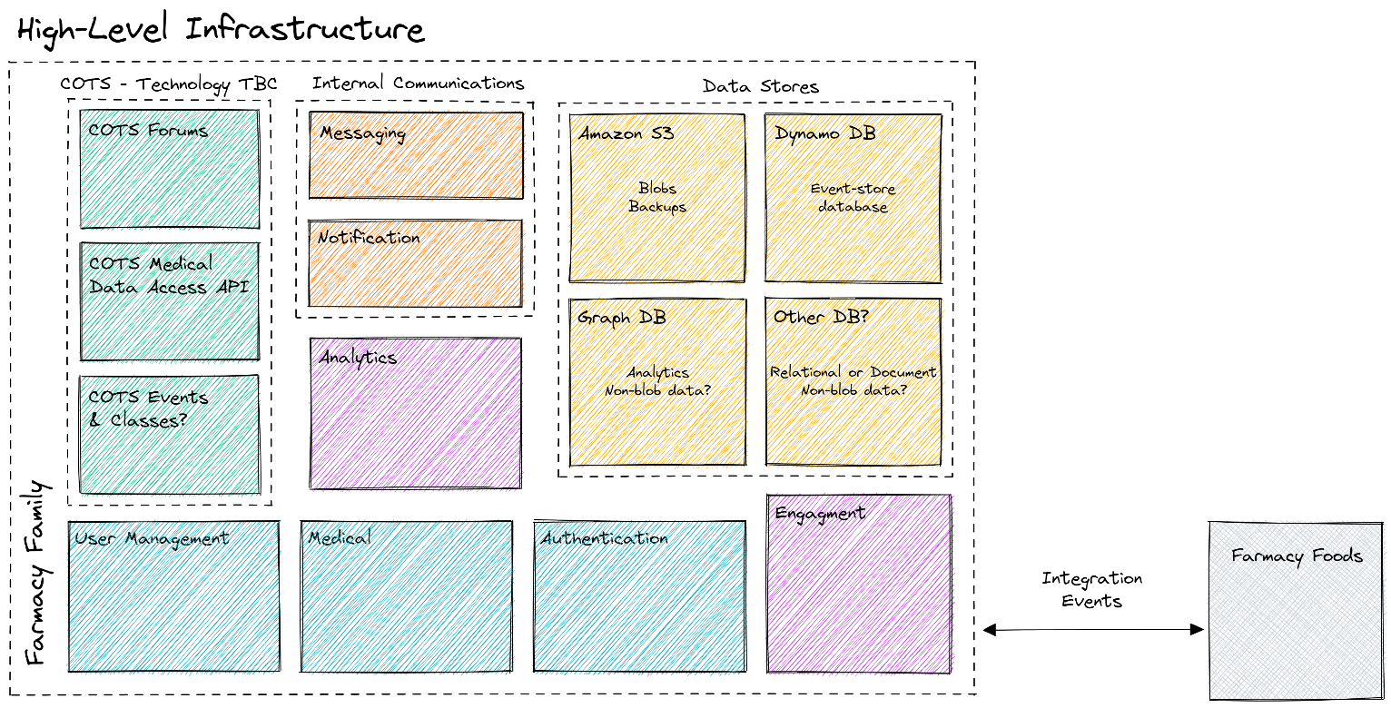
Notes:
High-level infrastructure diagram shows how the solution can be realized.

Slide 32
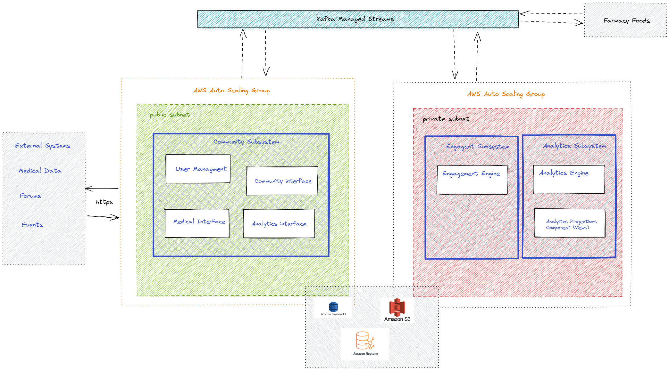
Notes:
The deployment on AWS has been designed in a similar manner to the Farmacy Foods for consistency.

Slide 33

Farmacy Family comes alive
Notes:
The solution is implemented and Farmacy Family comes alive!

Slide 34







Notes:
Happy users of the Farmacy Family & Farmacy Foods.
They interact with fellow members, get expert advice on nutrition and feed according to their medical and dietary needs.

